Slide 1

CONNECT
We offer new quality level of higher education.
The first application for universities in Uzbekistan

Slide 2
What we are?
We are helping to improve the interaction between university and a student by the news, rankings, reviews and more in one platform.

Slide 3



Why do you need us?
Anonymous reviews and ratings of teachers after each lesson
Quick access to current timetable with simply interface
Simplification of work with filling students’ CV.
1
2
3
Sometimes the teaching methods of teachers do not meet modern standards of pedagogy and administration, but students observe subordination.
It is not always convenient for students to download the schedule every week
Manual work when filling and editing documents spreadsheet related to students’ CV
Notes:
© Copyright PresentationGO.com – The free PowerPoint and Google Slides template library

Slide 4
Market Size
Numbers of universities
TAM
SAM
SOM
World : 25000
Local : 71
Tashkent : 27

Slide 5
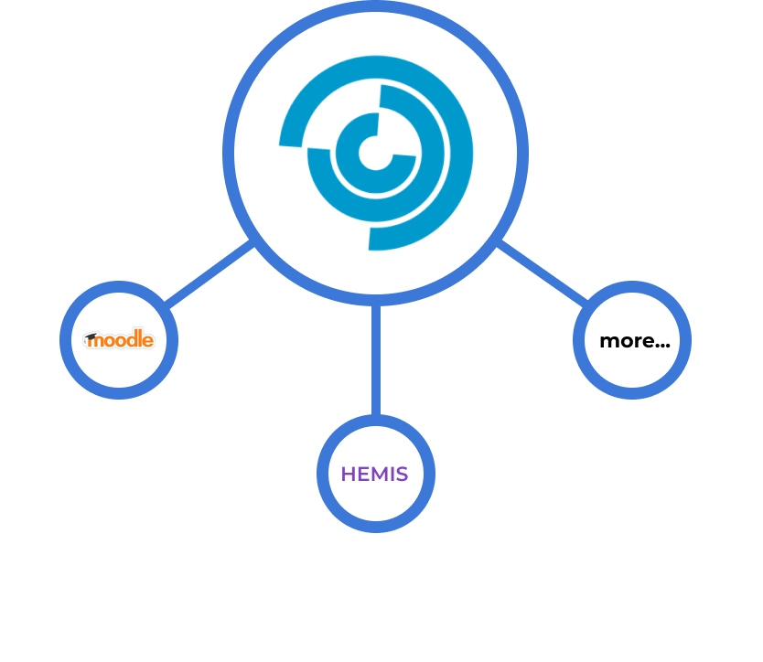
We can proudly say that we are the only ones
Also can cooperate with existing educational platforms of higher education

Slide 6

Monetization
We provide paid use of an annual subscription or free with ads

Slide 7
Milestones
2023-2024
2027
2022
2024-2025
Tashkent universities
Entry into the international market
Test connection for Gubkin university
All Uzbekistan universities

Slide 8

TEAM MEMBERS
Raupov Davlat - Mobile App dev, Project manager.
Rakhimov Javonsher - Backend dev.
Norov Akmal – Designer
Razzokov Shakhboz – Designer
Agishev Artur - Video maker

